Slide 1
SBOM Sprint #5
Thomas Eby, Pranav Gonepalli, Evan Hellersund, Manel Leong,
Camron Rule, Skyler Walker, Duohan Xu, Rachel Zheng
College of William & Mary
CSCI 435: Software Engineering
November 25, 2024

Slide 2
Sprint Goal
Add final major software functionality
More SBOM versions and vulnerabilities
Integrate license and vulnerability analysis into frontend

Slide 3
Sprint Backlog - Front end
New Feature Additions
License data pipeline to frontend (transmission, processing, display)
Vulnerability analysis display in frontend
Print PDF button on PDF Preview page
Add component details to sidebar in tree visualization page
Quality of Life Changes

Slide 4
Sprint Backlog - Backend
Refactor of parsers to use a factory design pattern
Split parsers into 4 classes
CycloneDx xml, CycloneDx Json, SPDX xml, SPDX Json
Improves readability
Implemented and integrated CycloneDx Json and XML parsers
Security vulnerabilities endpoint
License endpoint
Create RelationshipMap builder and endpoint
Bug fixes for TreeBuilder

Slide 5
Sprint Backlog - Backend
Works in progress
Integrating SPDX 3.0 Json parsing
Implementing SPDX 3.0 xml parsing
SPDX 2.2, 2.3 xml parsing

Slide 6
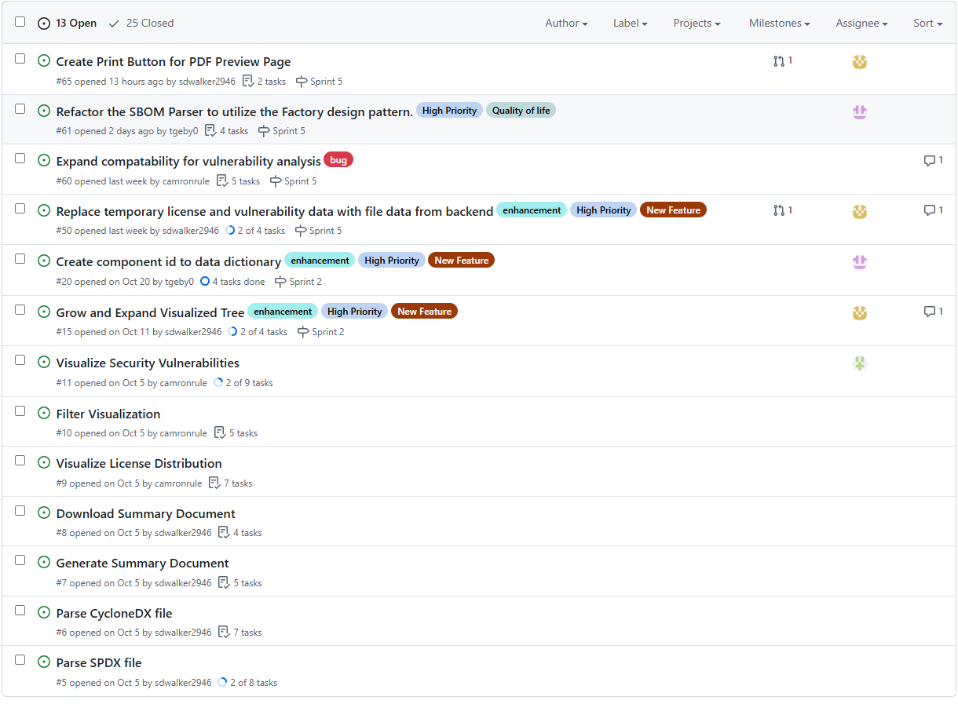
Issue Tracker

Slide 7
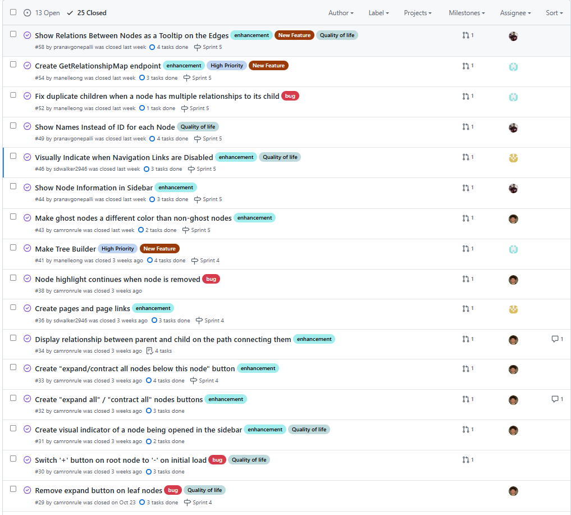
Issue Tracker (Continued)

Slide 8
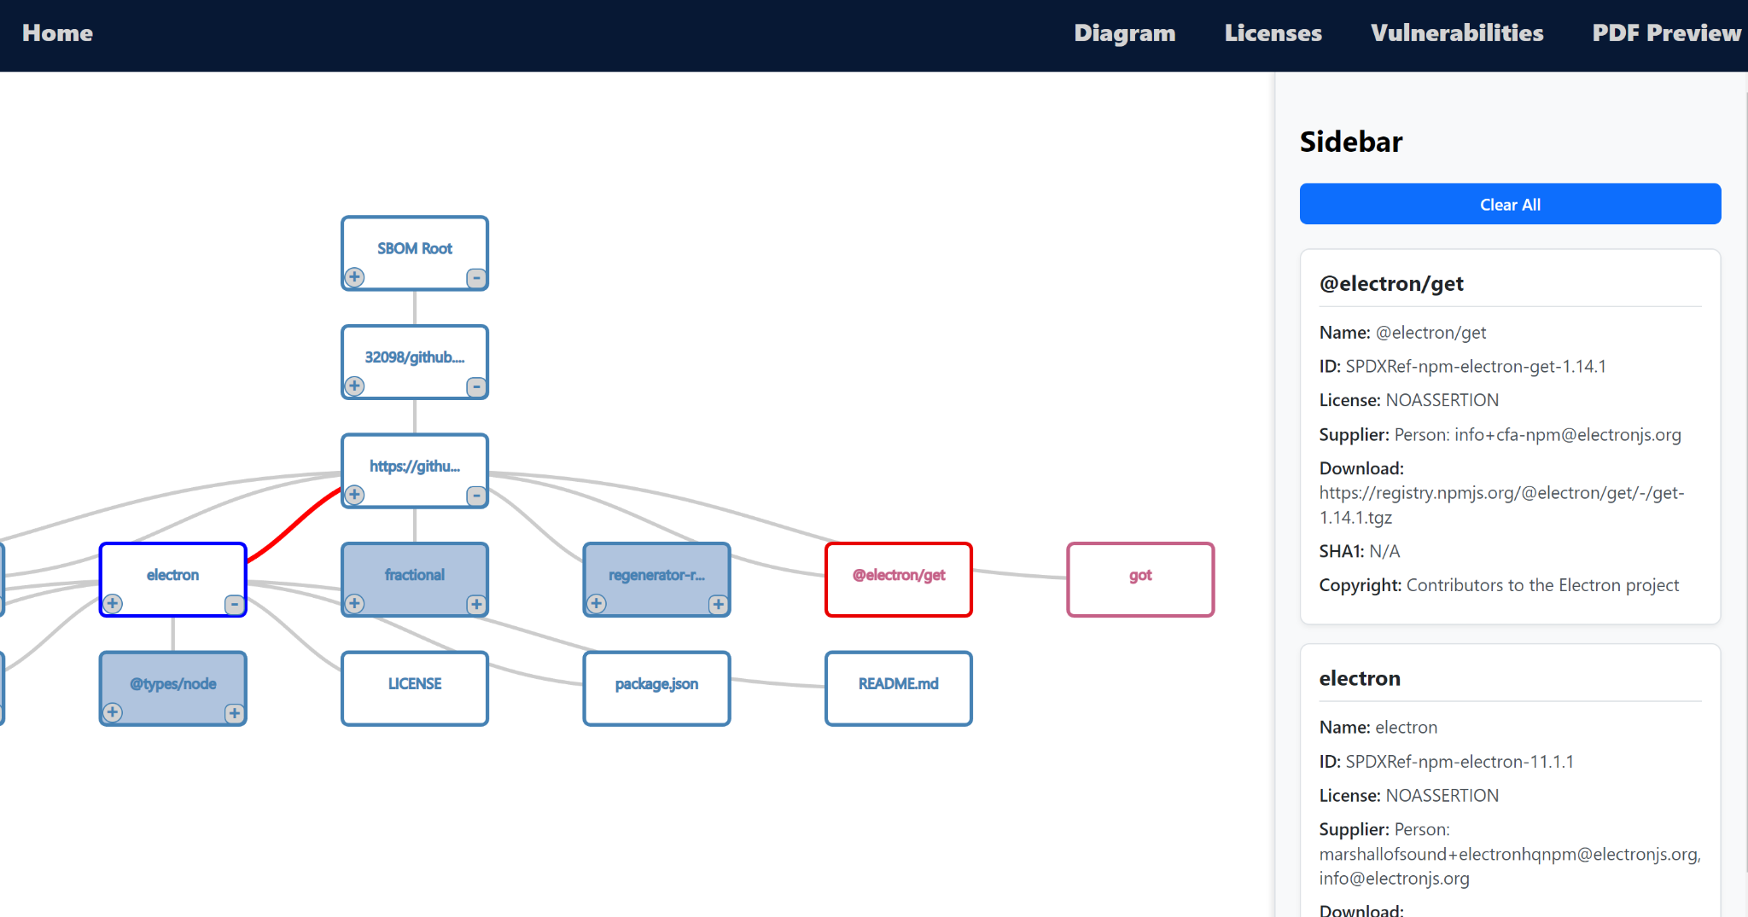
Tree Visualization Page

Slide 9
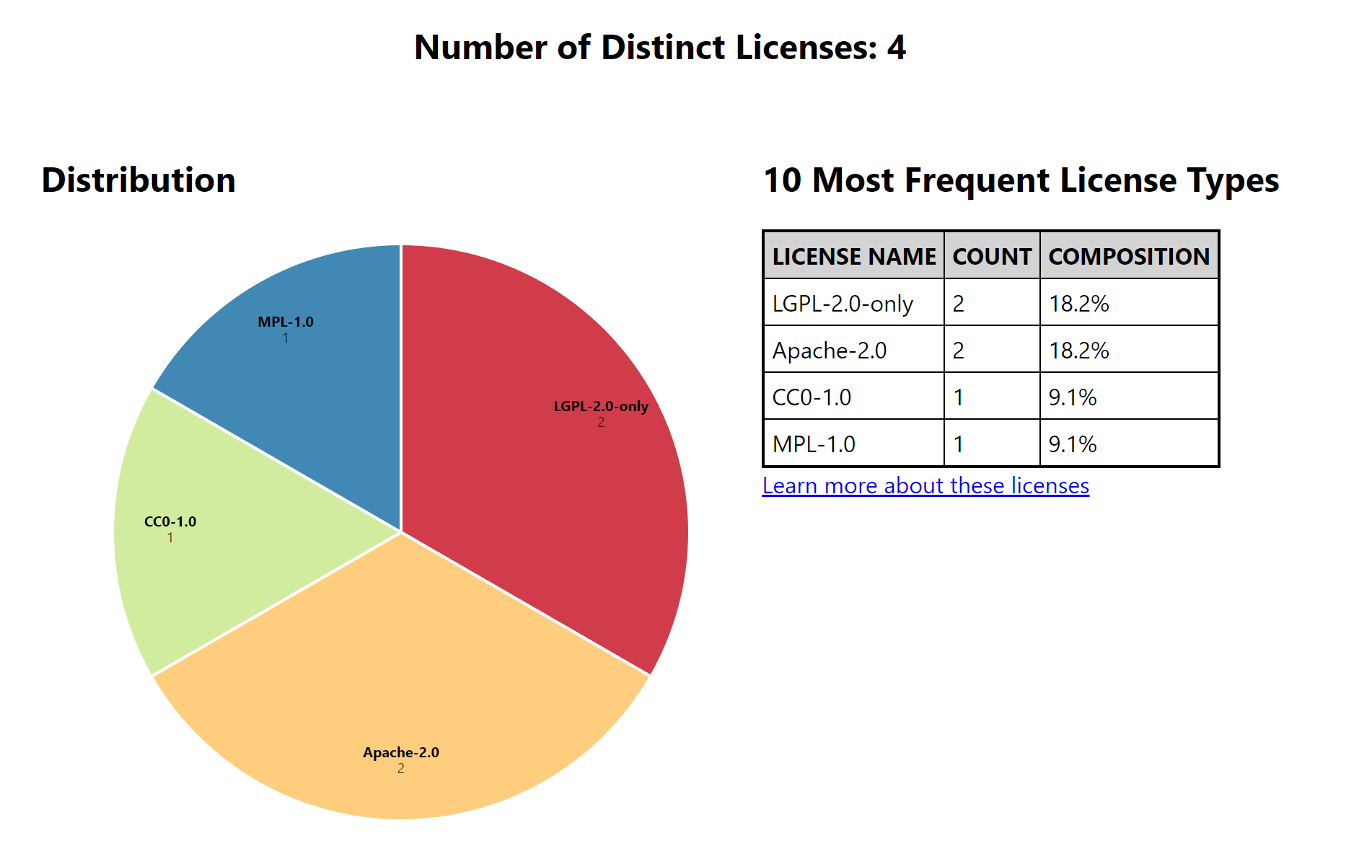
Licenses Page

Slide 10
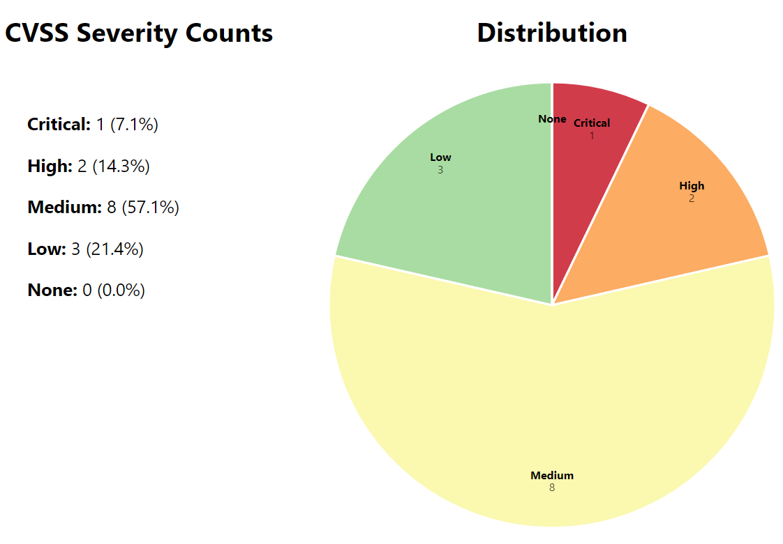
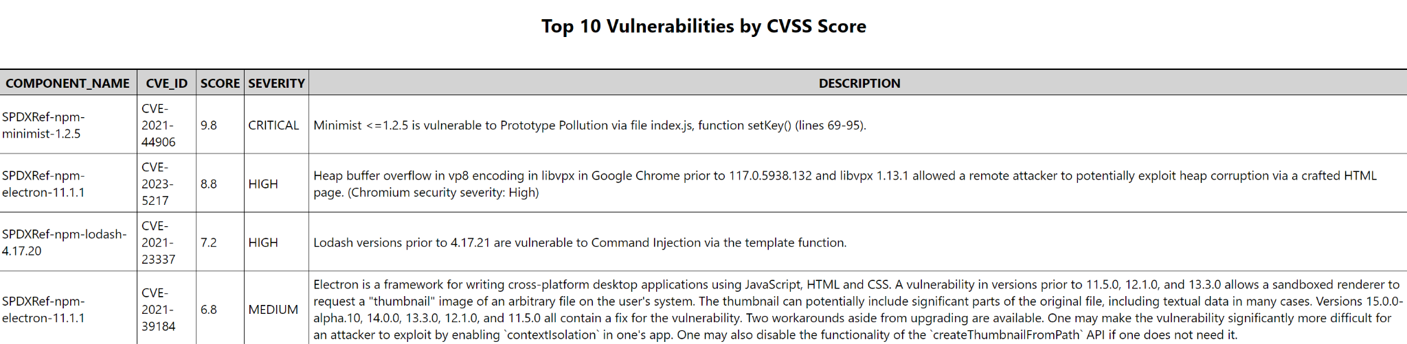
Vulnerabilities Page

Slide 11
Demo

Slide 12
Scanning for Security Vulnerabilities
The security scan fails on some sboms likely because of no purl component
To do:
Messaging for the user that security scanning failed/may not be as detailed
Test more sboms to improve robustness
Look into threads so security scan starts in the background
Write installation of security tools into documentation and explain clearly how security is evaluated

Slide 13
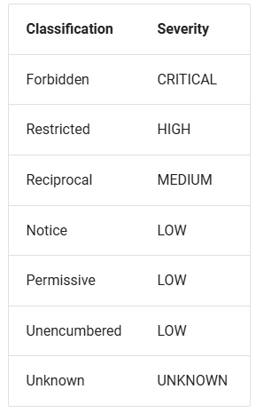
More in Depth License Analysis
Trivy categorizes the licenses into different categories based on restrictiveness and we can incorporate this information into the analysis we display in the frontend

Slide 14
Next Sprint Backlog
Improve compatibility of vulnerability analysis
Integrate SPDX 3.0 Json
Implement and integrate SPDX 3.0 XML
Finish and integrate SPDX 2.2, 2.3 XML
Make uml diagrams

Slide 15
Lessons
Backend tasks becoming numerous, need to redistribute labor to backend team.

Slide 16
Contributions
Manel: Created RelationshipMapBuilder and getRelationshipMap endpoint. Gave the idea to use a factory design pattern for building the parser. Worked on SPDX 2.2, 2.3 XML Parser.
Skyler: Integrated backend license data into frontend and implemented license processor, print preview button, and QoL changes to homepage
Thomas: Refactored app to use a factory design pattern when making the parser. Implemented Cyclone Dx Json and Xml parsers. Added license info endpoint.
Pranav: Made changes on the frontend, showing node information in the sidebar, and relationship between nodes as a tooltip on the edges.
Camron: Connected backend vulnerability output to the vulnerability analysis page, colored ghost nodes, improved documentation
Rachel: Improve error handling and compatibility for vulnerability scanning and looked into providing more information on licenses
Evan:.
Duohan: Implementing past mechanisms in parsers to refactored parsers
Everyone:

